Slide 1
Applications of Exponentials in Chemistry
Megan Gobeille
MATH A104
UAA

Slide 2
Review scientific notation if you don’t already know it.
There is a review video posted in MyOpenMath.

Slide 3

pH
pH is the negative log of the hydrogen ion concentration.
That means $pH=−log⁡[H^{+}]$

Slide 4

pH
pH is the negative log of the hydrogen ion concentration.
That means $pH=−log⁡[H^{+}]$
The lower the pH, the higher the acidity (which means more [H⁺]).
The higher the pH, the higher the basicity.

Slide 5
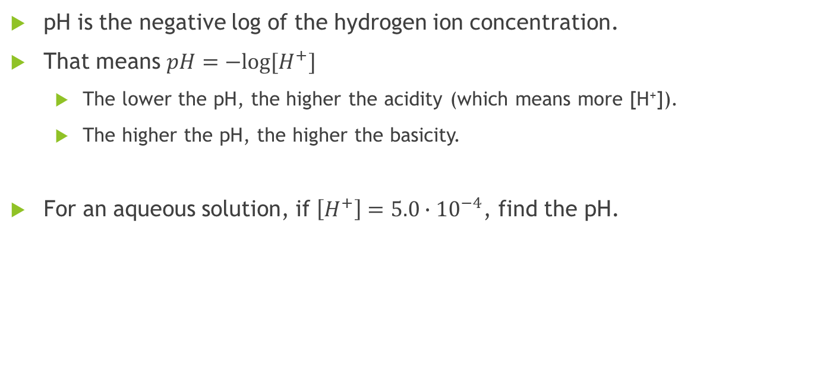
pH
pH is the negative log of the hydrogen ion concentration.
That means $pH=−log⁡[H^{+}]$
The lower the pH, the higher the acidity (which means more [H⁺]).
The higher the pH, the higher the basicity.
For an aqueous solution, if $\left[H^{+}\right]=5.0∙{10}^{−4}$, find the pH.

Slide 6

pH
$pH=−log⁡[H^{+}]$
If the pH of a solution is 9.70, what is the $\left[H^{+}\right]$?

Slide 7

Equilibrium equations
Given the equilibrium equation $K=1.15×{10}^{2}=\frac{{\left[HF\right]}^{2}}{\left[H_{2}\right]\left[F_{2}\right]}$, where
the concentration of $[HF]$ can be represented as $2.000+2x$,
the concentration of $[H_{2}]$ can be represented as $2.000−x$,
and the concentration of $[F_{2}]$ can be represented as $2.000−x,$
Find the value of x. This will tell us the equilibrium concentrations.

